Slide 1

“Major Project Review”
2016
Submitted as part of Major Project.
Ch.R.B.S Varsha (S160407)
B.Harshitha (S160947)
R.Prathyusha (S160577)
A.Katyayani (S160022)
Under the Supervision of:
Ms J.Vishnu Priyanka Mam
Assistant Professor
Department of Computer Science and Engineering
Rajiv Gandhi University of Knowledge Technologies
Srikakulam – 532402

Slide 2

Classification of Suicide and Depression using NLP

Slide 3
Contents
Abstract
Introduction
Technologies Used
Problem Statement
Implementation
Analysis of existing model
Proposed model
Results
Conclusion
References

Slide 4
ABSTRACT
In today’s world people are sharing their opinions, feelings in online platforms with strangers as they won’t be judged by doing this. So, many well-being applications are being developed and communities in social media applications are getting more, like reddit. Early detection of suicidal ideation in depressed individuals can allow for adequate medical attention and support, which in many cases is life-saving. There is little research into finding the line where depression turns into suicidal ideation, which is a more difficult clinical and technological task.
We use the data related to suicide and depression posts from applications like reddit which are posted by people with depressed thoughts. We classify the posts which are suicidal and depressed. We use lemmatization, sentiment analysis and topic modelling on the collected dataset and apply logistic regression to classify the posts according to the text analysis method outputs.

Slide 5
INTRODUCTION
Teenagers and young users more oftenly post about mental health on social media. Depression is the most pressing issue worldwide. People who are suffering from depression tend to have suicidal thoughts, if they are left unaddressed, there is a chance that they may commit suicide.
Reddit is a social media platform where people post about their feelings anonymously. We are considering two subreddits r/depression and r/suicidewatch to scrap the data.They are considered benchmark spaces where people frequently post what they are feeling and they are supportive spaces in which people encourage and push each other. We use the scraped dataset to categorize depressed and suicidal thoughts.

Slide 6
TECHNOLOGIES USED
Software Requirements:
Python 3.6
Jupyter Notebook/ Google Collab
Windows 8/9/10 or Linux OS
Hardware Requirements:
Intel i5 Processor
Laptop/Desktop
4GB RAM
Technologies Used:
Python
Data:
Reddit (subreddits)
SuicideWatch subreddit
Depression subreddit

Slide 7
PROBLEM STATEMENT
To analyze and build a machine learning model, that categorizes the reddit data into suicide and depression using Natural Language Processing(NLP) which helps in aiding the people suffering with depression and suicidal thoughts.

Slide 8
Analysis of Existing Methods/Models/Algorithms
In the existing system,
The project aims to use natural language processing, machine learning techniques, and neural network architectures to build models that classify Reddit text comments as "depressed" or "non-depressed."
The models used are BERT(Bidirectional Encoder Representations from Transformers) and CNN(Convolutional Neural Networks) for classifying depressed posts.

Slide 9
Proposed System
In proposed system,
Scraping reddit data from sub-reddits like suicideWatch and depression and analyzing it for calculating the mindset of an individual.
Performing sentiment analysis for analyzing whether reddit provides positive environment for the people lacking support at home or who prefer to be anonymous.
Tokenizer in NLTK splits a string into list of tokens or words and Lemmatization is performed for morphological analysis of the words in that list.
We used TF-IDF Vectorization to identify words that vary between suicide and depression posts.
MDS Visualization is used for data visualization for classified dataset representation which we are using logistic regression for the classification.
Topic modelling makes the words to be easily classified into required categories in this model.

Slide 10
IMPLEMENTATION
Steps and Algorithmic methods used to build the model:
Data Scraping from reddit
Sentimental Analysis
TF-IDF Vectorization
Cosine-Similarity
MDS Visualisation on reddit posts
Topic modelling using LDA

Slide 11
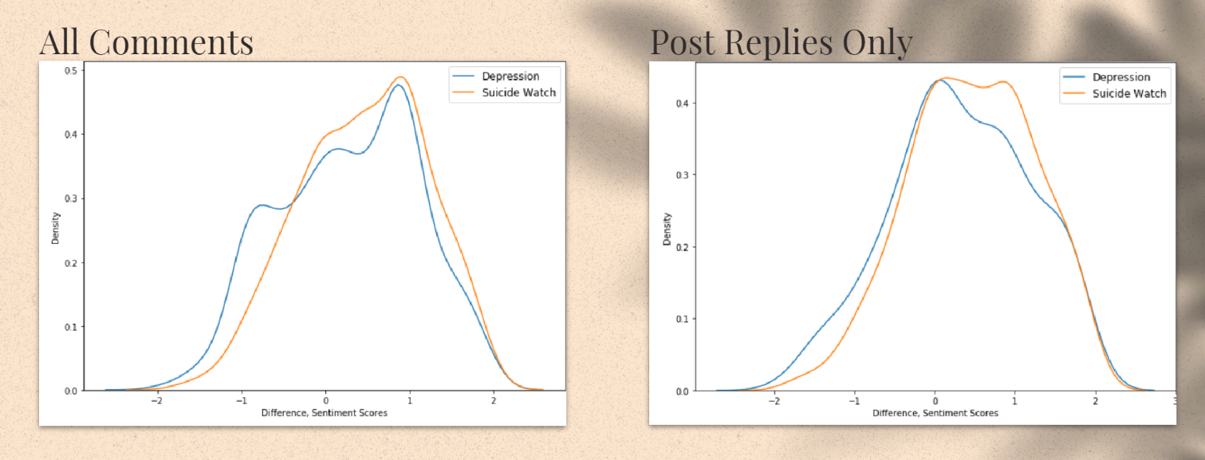
Web Scraping

Slide 12
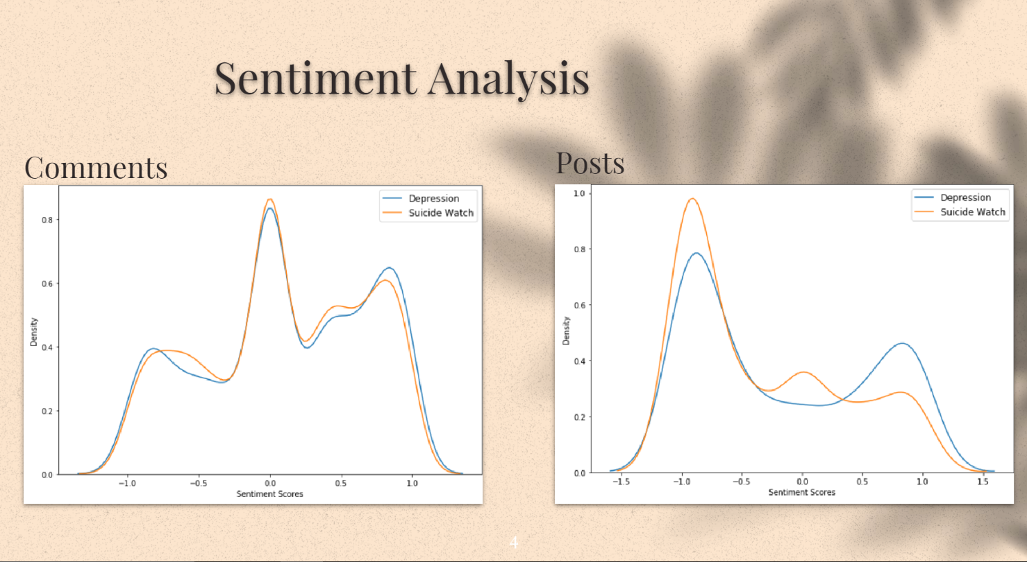

Slide 13
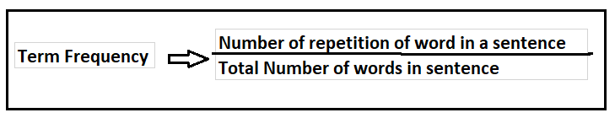
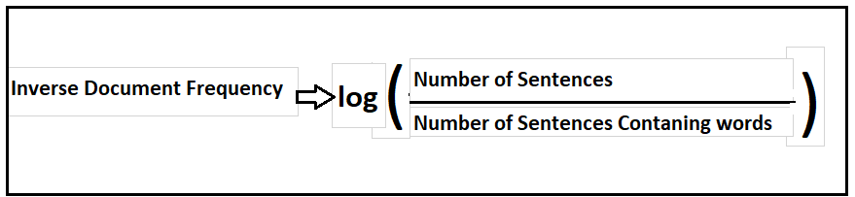
TF-IDF Vectorization
TF-IDF means Term Frequency - Inverse Document Frequency
It gives a measure that takes the importance of word into consideration depending on how frequently it occurs in a document or a corpus
TF means we find frequency of a word in the document
IDF measures the importance of the word in corpus

Slide 14
Cosine similarity
It is used to measure the similarity in text analysis.
Cosine similarity is represented by cos theta.
Theta is the angle between points.
Always ranging between -1 to +1.
For example, cos 45 =0.53 that means similarity is around 53%.
cos 90 =0 that means points are not similar.
If θ = 0°, the ‘x’ and ‘y’ vectors overlap, thus proving they are similar.
f θ = 90°, the ‘x’ and ‘y’ vectors are dissimilar.
similarity measure refers to distance with dimensions representing features of the data object, in a dataset. If this distance is less, there will be a high degree of similarity, but when the distance is large, there will be a low degree of similarity.

Slide 15
In cosine similarity, data objects in a dataset are treated as a vector. The formula to find the cosine similarity between two vectors is –
Cos(x, y) = x . y / ||x|| * ||y||
where,
x . y = product (dot) of the vectors ‘x’ and ‘y’.
||x|| and ||y|| = length of the two vectors ‘x’ and ‘y’.
||x|| * ||y|| = cross product of the two vectors ‘x’ and ‘y’.
The cosine similarity is beneficial because even if the two similar data objects are far apart by the Euclidean distance because of the size, they could still have a smaller angle between them. Smaller the angle, higher the similarity.
When plotted on a multi-dimensional space, the cosine similarity captures the orientation (the angle) of the data objects and not the magnitude.

Slide 16
MDS Visualization
MDS (Multidimensional Scaling) is an algorithm that transforms a dataset into another dataset, usually with lower dimensions, keeping the same euclidean distances between the points.
MDS, also known as Principal Coordinates Analysis(PCoA), is a statistical technique originating in psychometrics.
The data used for multidimensional scaling (MDS) are dissimilarities between pair of objects.
The main objective of MDS is to represent these dissimilarities as distances between points in a lower dimensional space such that the distances correspond as closely as possible to the dissimilarities.

Slide 17
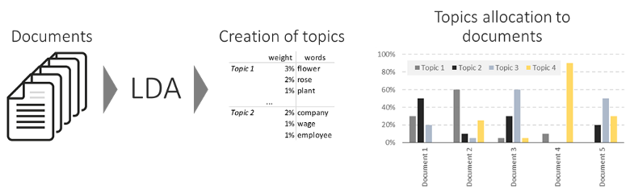
Topic Modelling using LDA
Topic modelling refers to the task of identifying topics that best describes a set of documents. These topics will only emerge during the topic modelling process (therefore called latent). And one popular topic modelling technique is known as Latent Dirichlet Allocation (LDA).

Slide 18
Perplexity and Coherence
The perplexity metric in NLP is a way to capture the degree of ‘uncertainty’ a model has in predicting (i.e. assigning probabilities to) text.Presented with a well-written document, a good language model should be able to give it a higher probability than a badly written document, i.e. it should not be “perplexed” when presented with a well-written document.
Topic Coherence measures score a single topic by measuring the degree of semantic similarity between high scoring words in the topic. These measurements help distinguish between topics that are semantically interpretable topics and topics that are artifacts of statistical inference.
A set of statements or facts is said to be coherent, if they support each other.
The lower the perplexity, the higher the coherence , the better the model is.

Slide 19
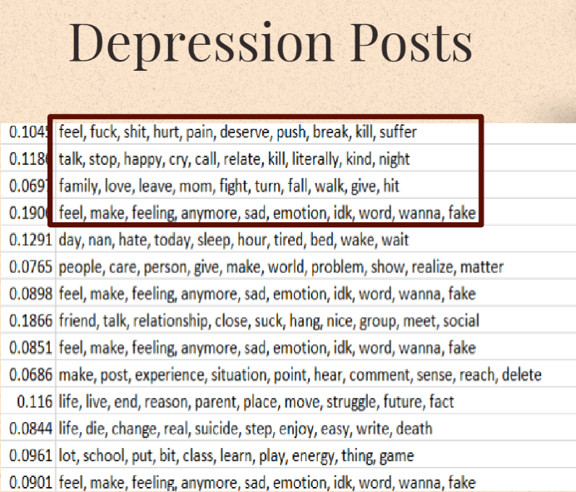
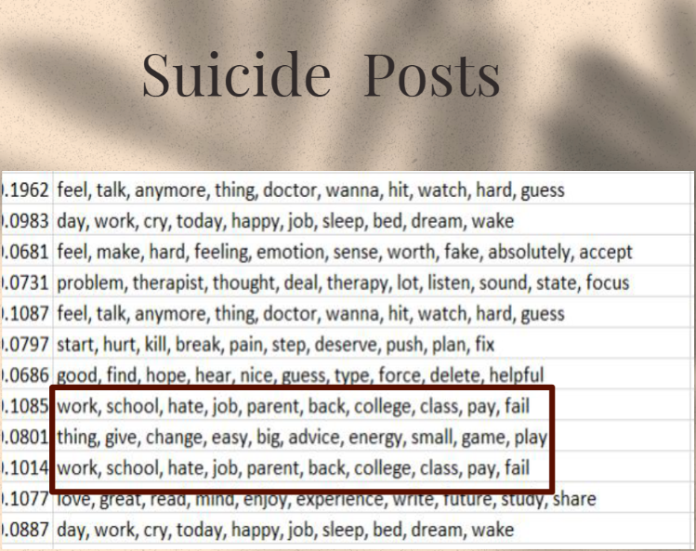

Slide 20
Results
Sentiment analysis validates that the suicide watch and depression platforms on reddit provides a positive environment for people lacking support at home or who prefer to be anonymous.
MDS Visualization shows the plotting of posts according to their classification as suicide or depression in 2-dimentional graphical representation.
TF-IDF shows top identifying words vary between suicide and depression.
LDA shows dominant topics vary between suicide and depression.

Slide 21
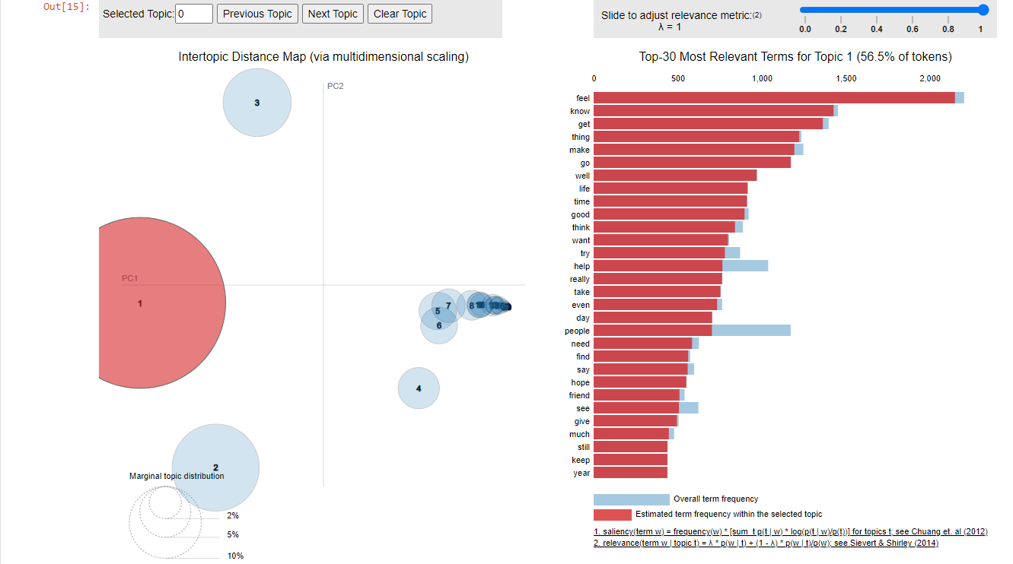

Slide 22
CONCLUSION
Starting with the reddit recent post data by scraping subreddits, we have implemented few methods and classification algorithms like, TF-IDF Vectorization, Lemmatization, Text Modelling, Logistic Regression and MDS Visualization for classifying dataset as suicidal and depressed posts.
Thus, we used the above methods after learning and researching about existing model to make a proposed system.

Slide 23
REFERENCES
S.No. | Author & Year | Title of the Reference Paper | Links/Analysis
1 | Kali Cornn | Identifying Depression on Social Media | 15712307.pdf (stanford.edu)
2 | Viridiana Romero Martinez, 2019 | A machine learning approach for the detection of depression and mental illness in Twitter | A machine learning approach for the detection of depression and mental illness in Twitter | by Viridiana Romero Martinez | DataDrivenInvestor
3 | Scikit learn Developers | Gaussian Mixture Models | 2.1. Gaussian mixture models — scikit-learn 1.0.2 documentation
4 | Yamini, Analytics Vidya, 2021 | Topic Modelling | Topic Modelling | Topic Modelling in Natural Language Processing (analyticsvidhya.com)

Slide 24
THANK YOU

